Slide 1
Tools to simplify appointment setting
October 2022

Slide 2
Making Time for Customers
Calendar
Appointment app
Share access

Slide 3
We all have a calendar
Microsoft Outlook https://outlook.live.com/calendar/
Google Calendar
https://calendar.google.com/
Apple iCalendar
https://apps.apple.com/us/app/icalendar/id492076105

Slide 4
Appointment Services (1 of 2)
Calendly
https://calendly.com/
Hubspot
https://app.hubspot.com/signup-hubspot/sales?hubs_campaign=hubspot-meetings-virality&hubs_cta=booking-page-signup-visual&intent=salesMeetings&opt_sidebar=meeting&utm_medium=virality&viralSourcePortalId=434177&step=landing_page

Slide 5
Appointment Services (2 of 2)
Review of other services:
7 Best Free Appointment Scheduling Software for 2022
https://zapier.com/blog/best-appointment-scheduling-apps/

Slide 6
Share Your Link
Every appointment app provides a link to share.
This link can be included in your email footer, on your website, on your Facebook and LinkedIn pages, and other directories
Create a QR code to share via cell phone

Slide 7
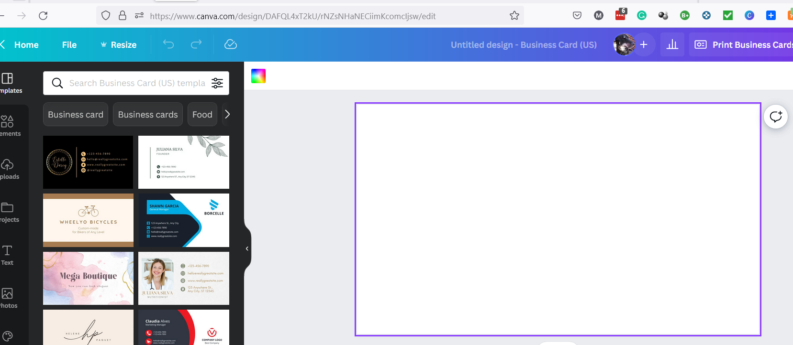
Creating a QR Code (1 of 4)
Use Canva to generate QR codes
https://www.canva.com/
Create a business card

Slide 8
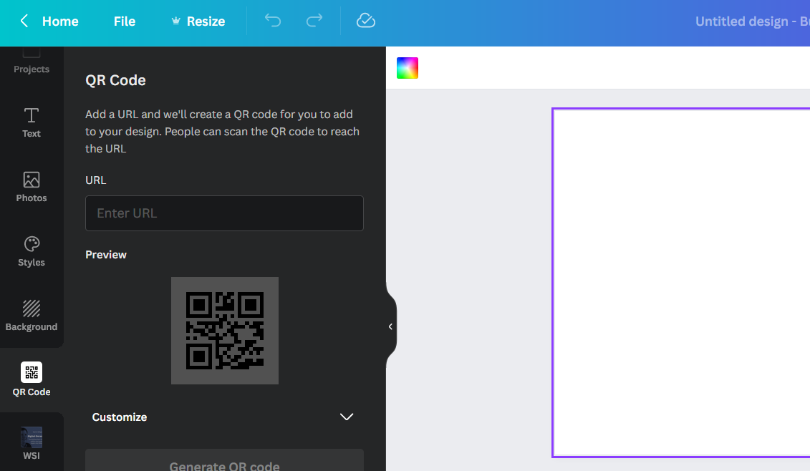
Creating a QR Code (2 of 4)
Select QR Code on the left

Slide 9
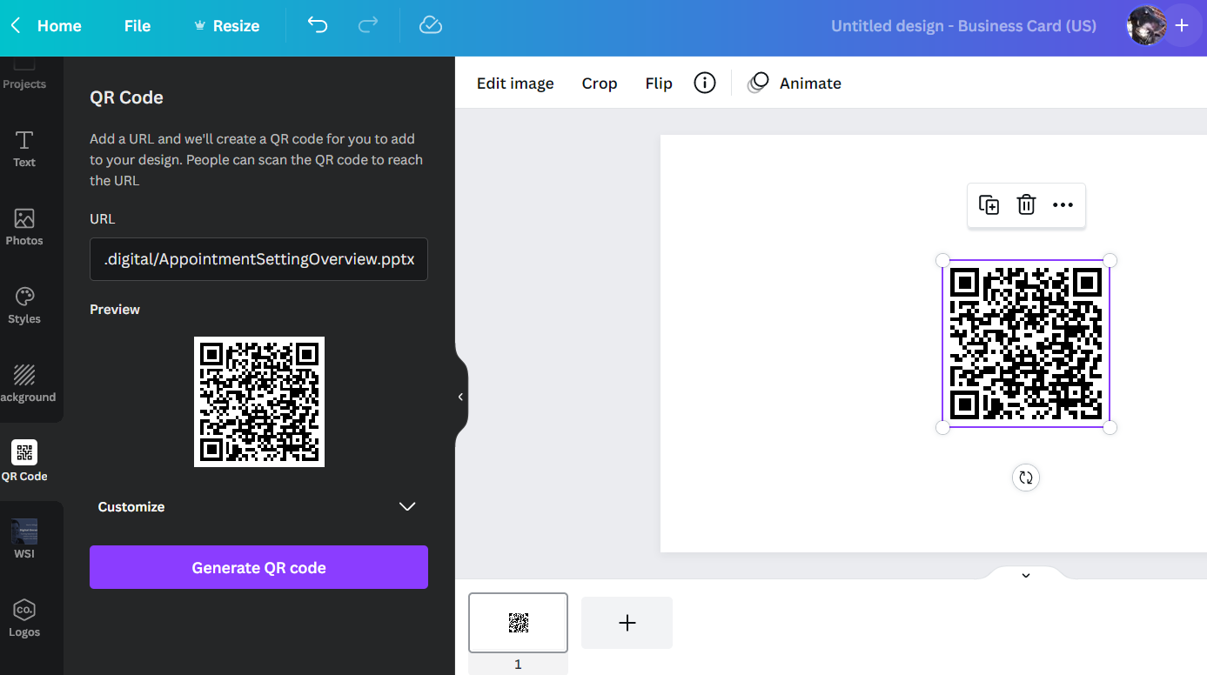
Creating a QR Code (3 of 4)
Paste you appointment URL and generate QR code.

Slide 10
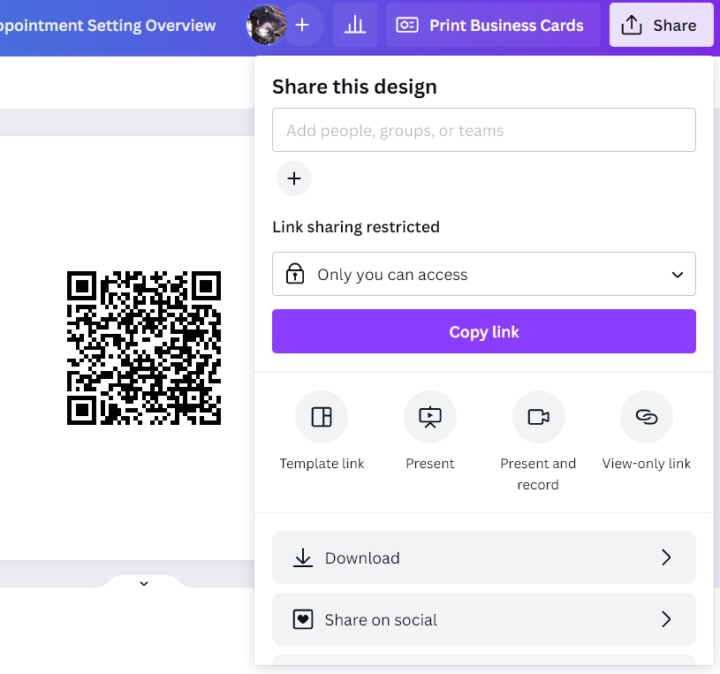
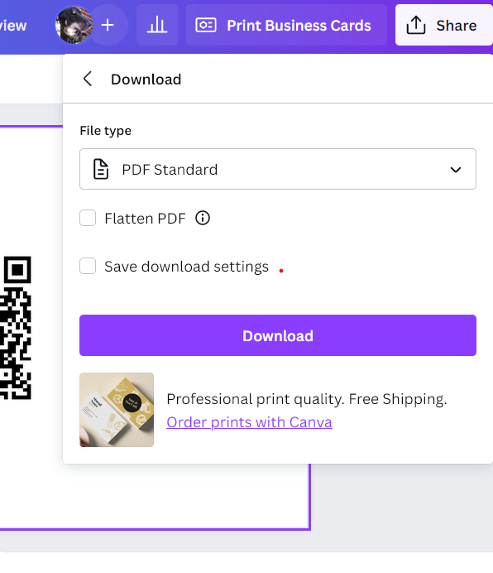
Creating a QR Code (4 of 4)
Select “Share” and then “Download”
Choose “pdf” and download

Slide 11
Store on Your Phone
Up load the PDF to your phone
If you have a Google account this is easy
  Upload to Google account from computer
  Open Google Drive on phone
Share with your customer or prospect
  Open PDF on phone
  Have client scan QR to set up meeting

Slide 12
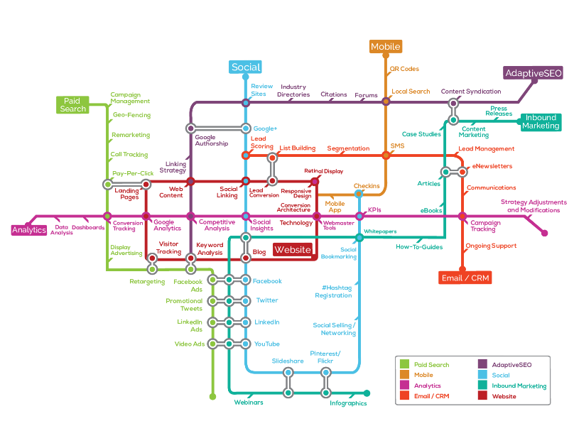
Marketing Technology

Slide 13
Q&A
©2019 WSI. All rights reserved.

Slide 14
Thank You
©2019 WSI. All rights reserved.

